Slide 1
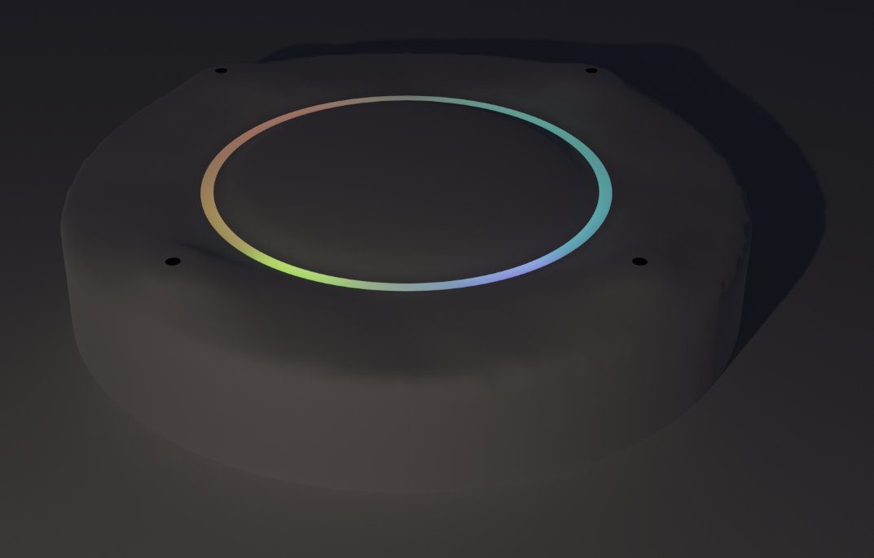
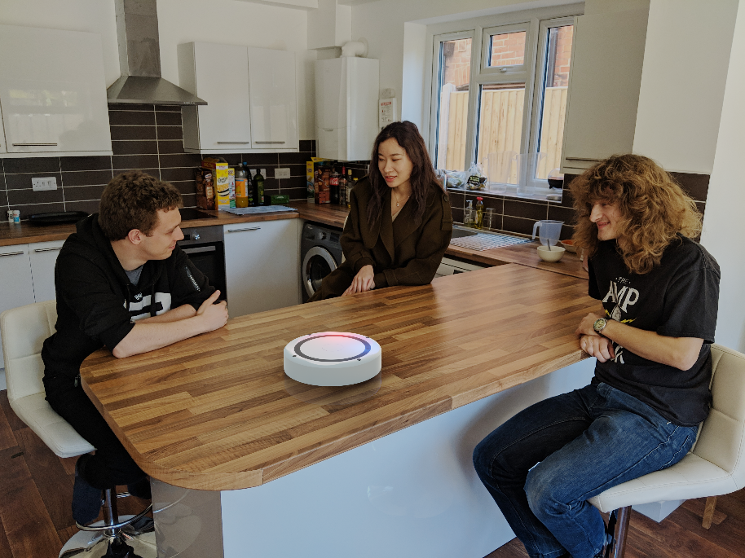
DAISIES
Deaf-Assisting Incident Sound Inclination Evaluator and Show-er
D4 Team Chinchilla

Slide 2

Problem and Target Market
11 million people with hearing problems*
Ensuring they feel included
Detects angle, intensity and frequency of sound
Unique product?
*https://www.actiononhearingloss.org.uk/about-us/our-research-and-evidence/facts-and-figures/

Slide 3
Costing
Priced at £175 (in run of 10k devices)
Profitable at 3000 sales

Slide 4
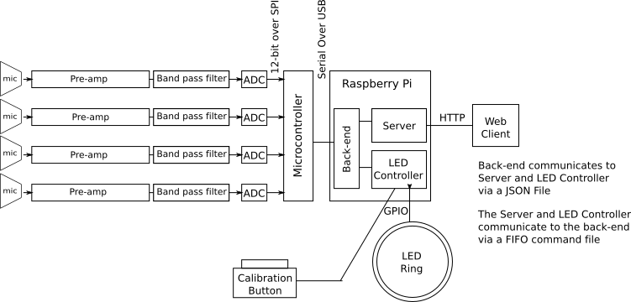
Design

Slide 5
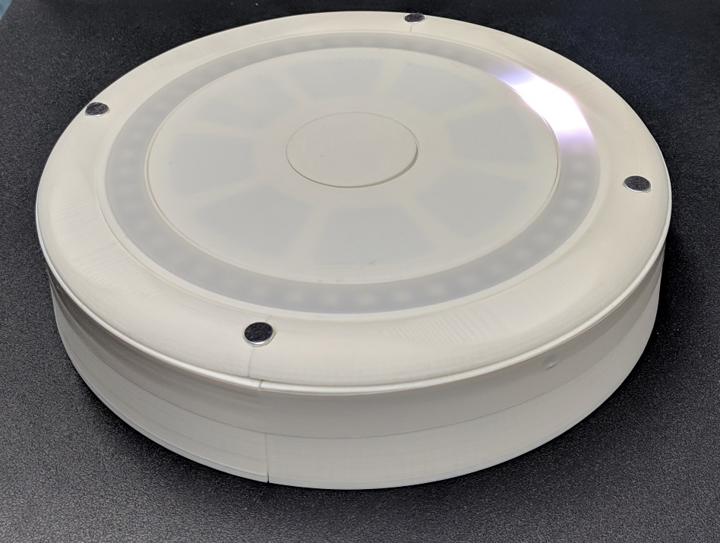
Prototype
Very time-sensitive software
Everything on critical path
Lack of integration time

